Slide 1
Hine Solicitors
Diversity Report 2025
[NB; figures based on information collected in June 2025]

Slide 2
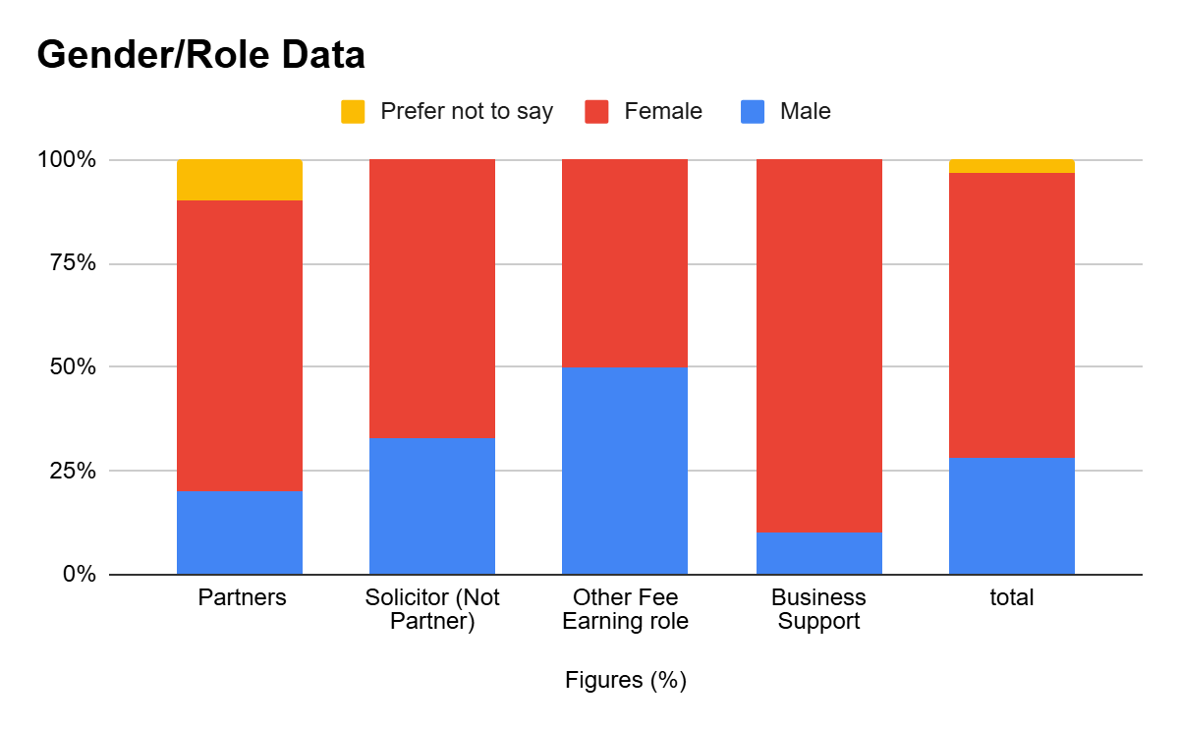
Gender diversity report 2025
70% of our Partners are Female
10%
3%
Overall, 69% of our staff is female and 28% are Male
50%
67%
70%
90%
69%
50%
20%
33%
28%
10%

Slide 3
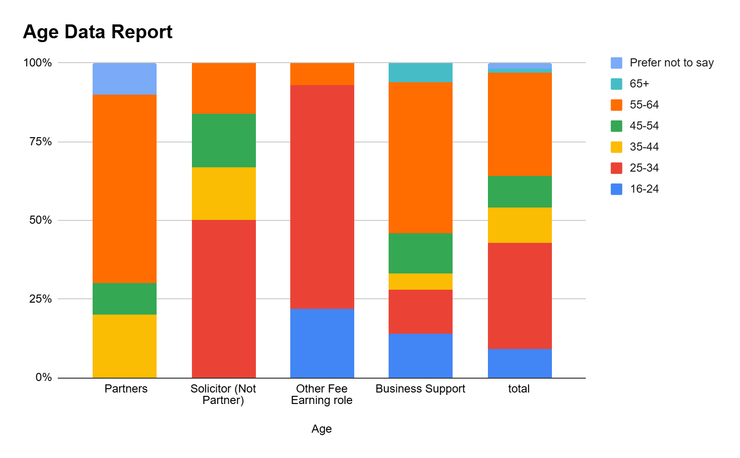
Age data report 2025
2%
1%
1%
7%
6%
2%
10%
16%
7%
6%
50% of our Solicitors are 25-34
9% of our staff are 16-24
10%
3%
10%
16%
7%
1%
16%
25%
16%
40%
34%
33%
17%
17%
48%
9%
16%
8%
17%
71%
56%
10%
10%
60%
17%
17%
60%
71%
60%
71%
10%
3%
11%
7%
13%
13%
46%
10%
5%
10%
50%
30%
100%
50%
5%
20%
22%
14%
34%
10%
50%
9%
14%
34%
20%
22%
9%
14%
20%
22%
14%
9%

Slide 4
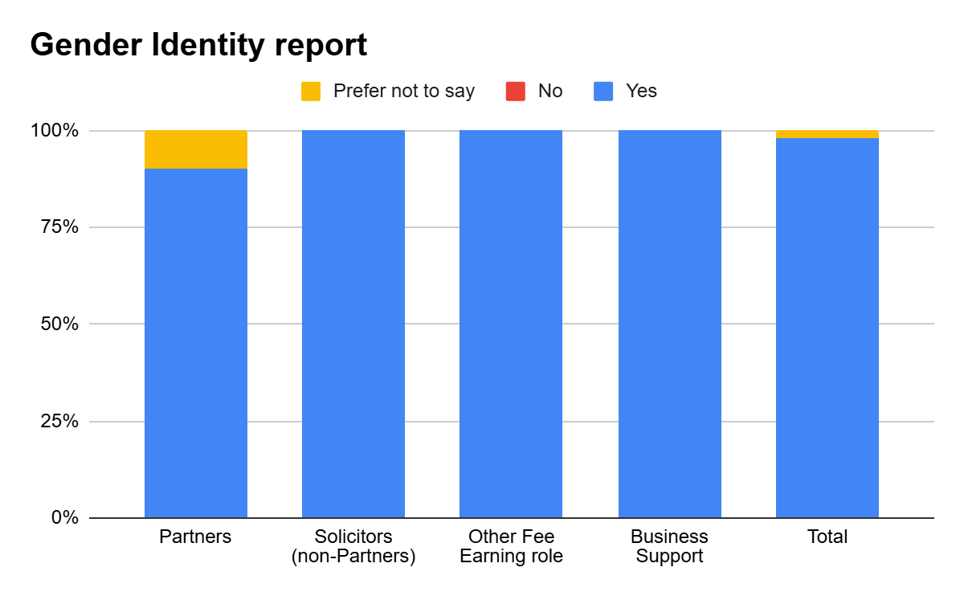
Gender Identity report 2025
Do our employees identify as the same Gender they were registered as at birth?
2%
10%
2%
90%
100%
100%
100%
100%
90%
100%
100%
98%
100%
98%

Slide 5
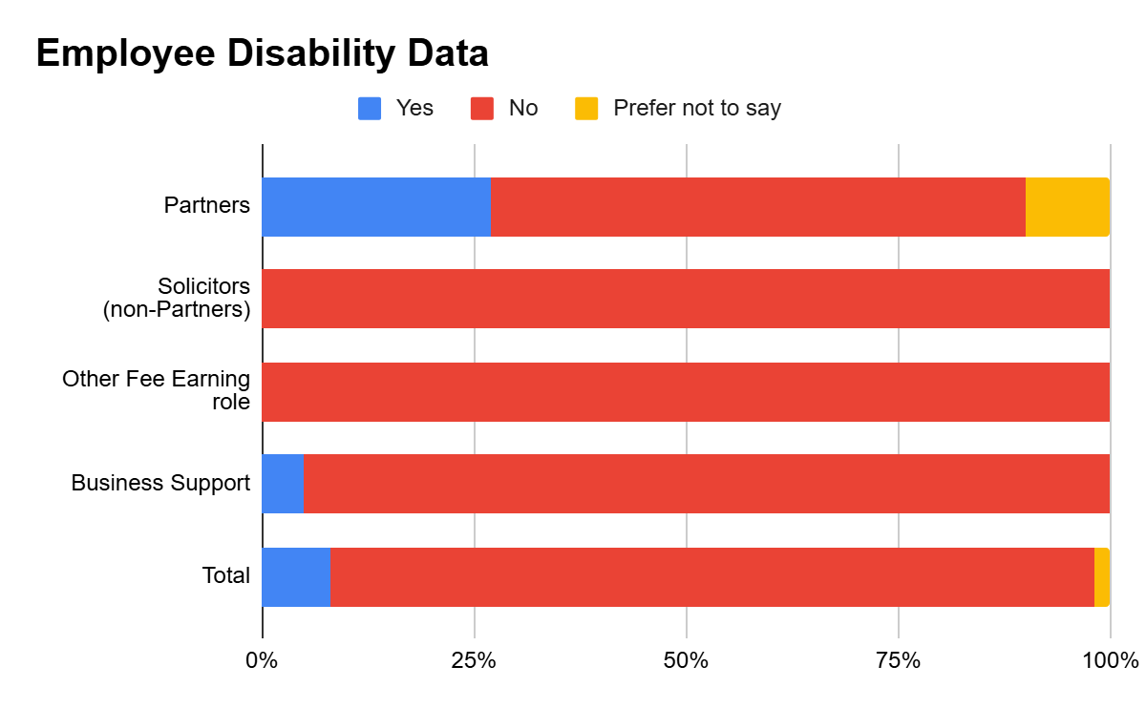
Disability in the workplace:
How Many of our employees consider themselves to have a disability in accordance with the Equality Act 2010?
27%
63%
10%
27%
63%
10%
100%
100%
100%
100%
10%
90%
5%
95%
8% of our staff consider themselves to have a disability.
100%
8%
90%
2%
7%
91%
2%

Slide 6
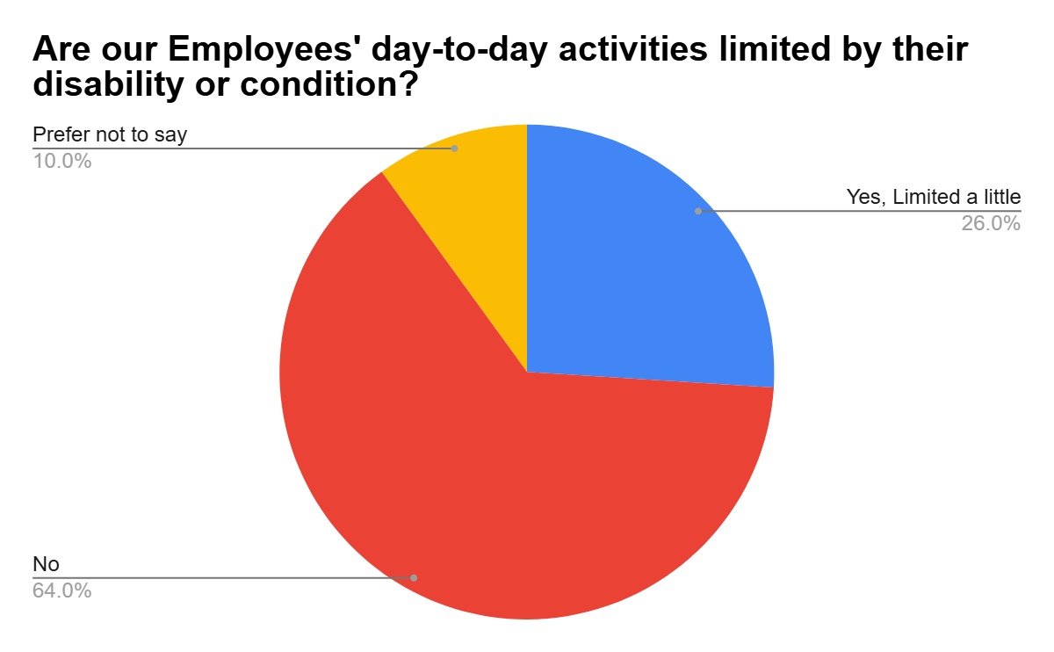
Disability report: Further insight

Slide 7
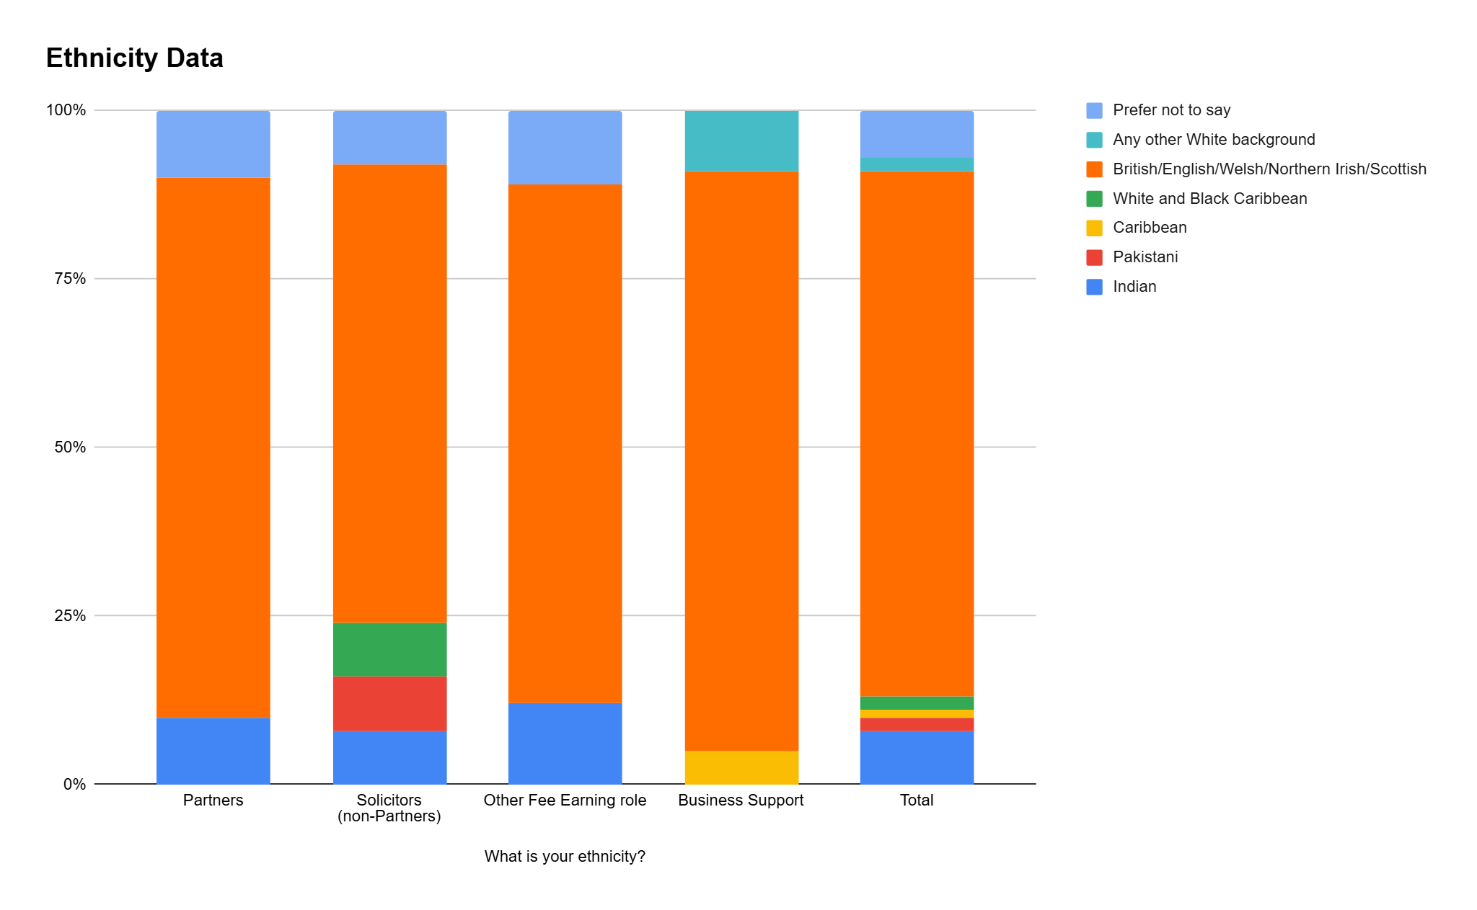
Our Employees; Ethnicity Data Report
8%
9%
7%
10%
11%
2%
10%
8%
25%
9%
10%
2%
10%
8%
8%
25%
20%
4%
78%
68%
80%
80%
68%
76%
77%
68%
68%
8%
68%
86%
75%
8%
100%
77%
10%
8%
14%
4%
6%
22%%
8%
86%
80%
8%
8%
1%
2%
10%
8%
8%
14%
5%
8%
1%
10%
8%
12%
5%
8%
2%
2%

Slide 8
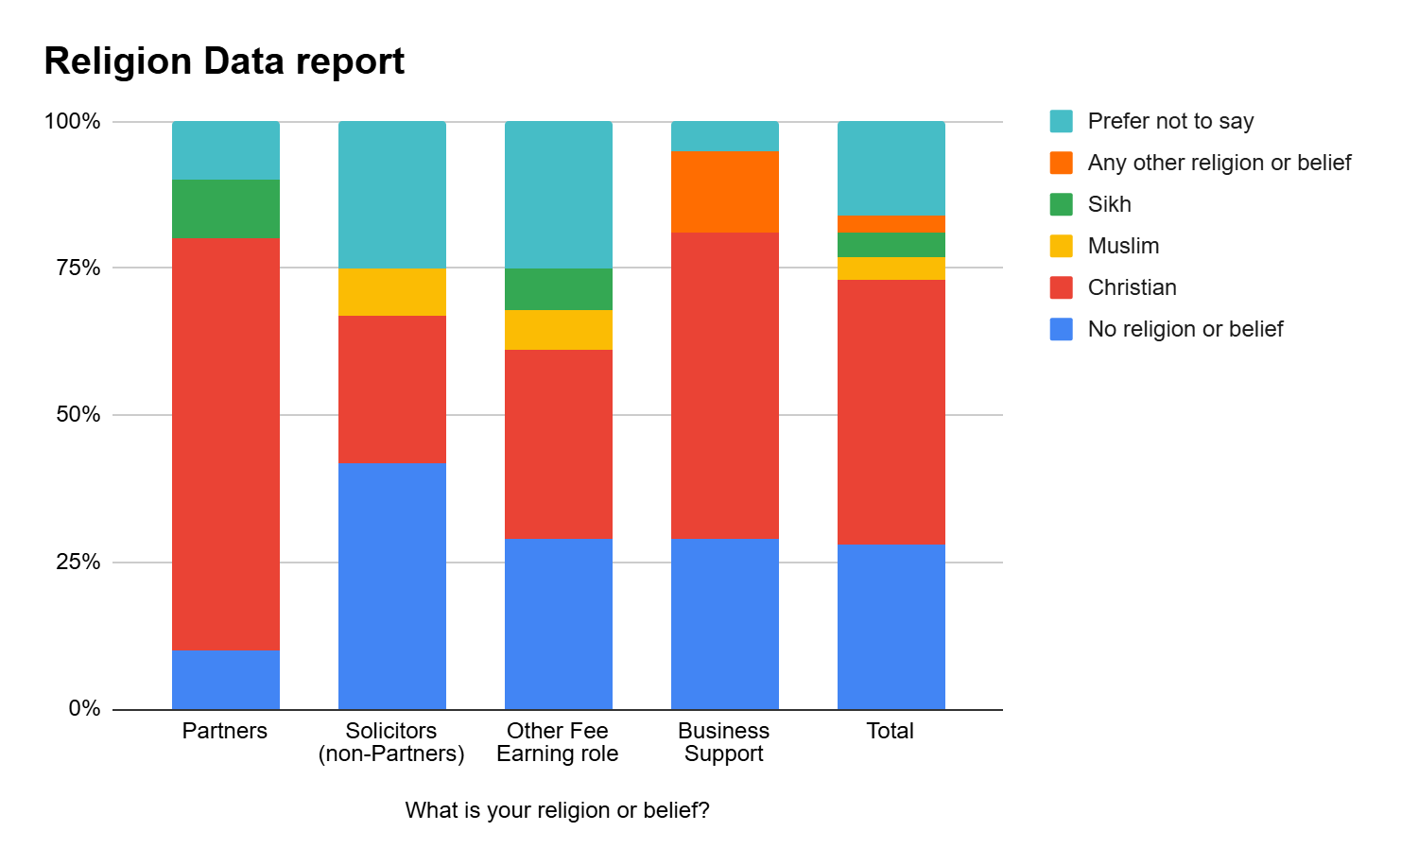
Religion Data; Employee report 2025
10%
5%
16%
10%
25%
25%
14%
3%
10%
3%
13%
4%
25%
4%
25%
6%
10%
8%
7%
3%
7%
8%
7%
30%
3%
7%
25%
25%
52%
35%
32%
45%
32%
50%
70%
70%
10%
42%
29%
17%
100%
40%
10%
42%
29%
29%
28%

Slide 9
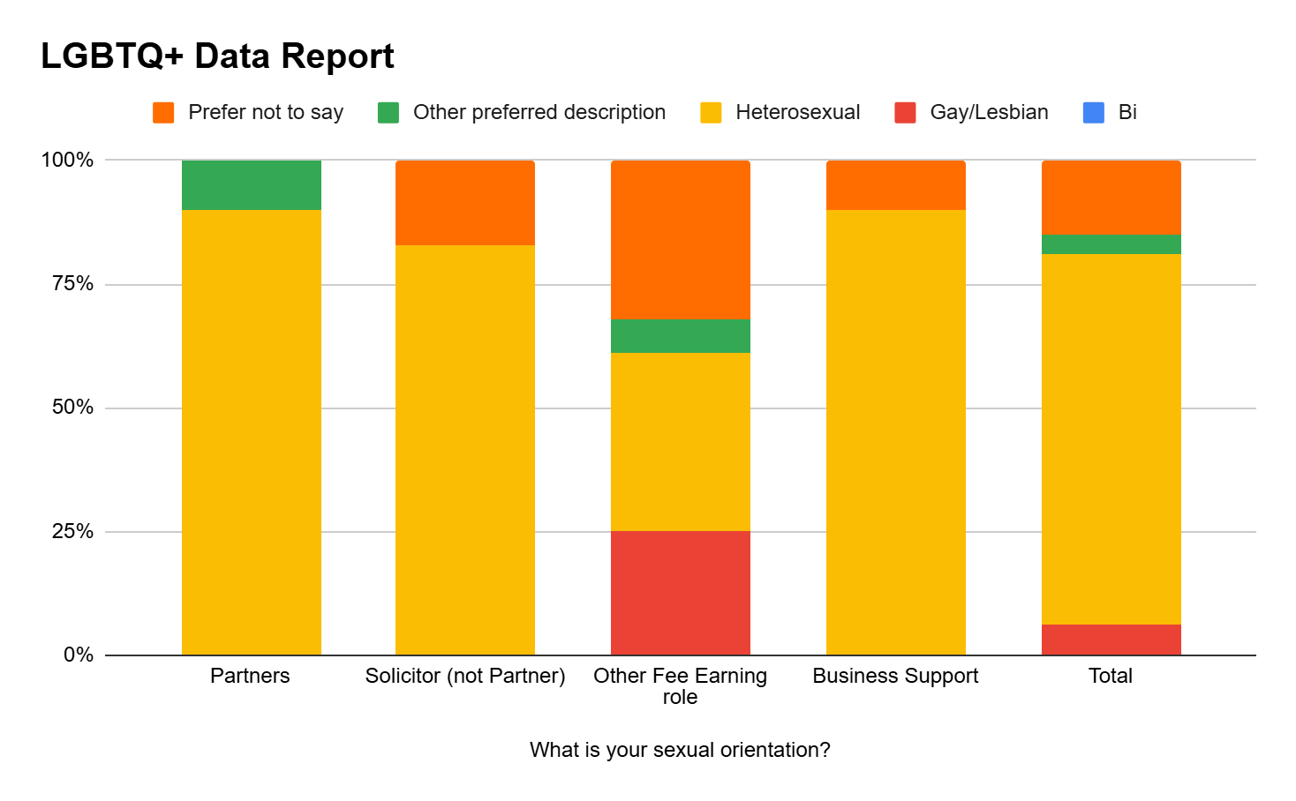
LGBTQ+
10%
17%
10%
15%
10%
17%
32%
13%
12%
4%
32%
4%
7%
7%
36%
36%
25%
75%
90%
90%
83%
83%
87%
100%
90%
79%
6%

Slide 10
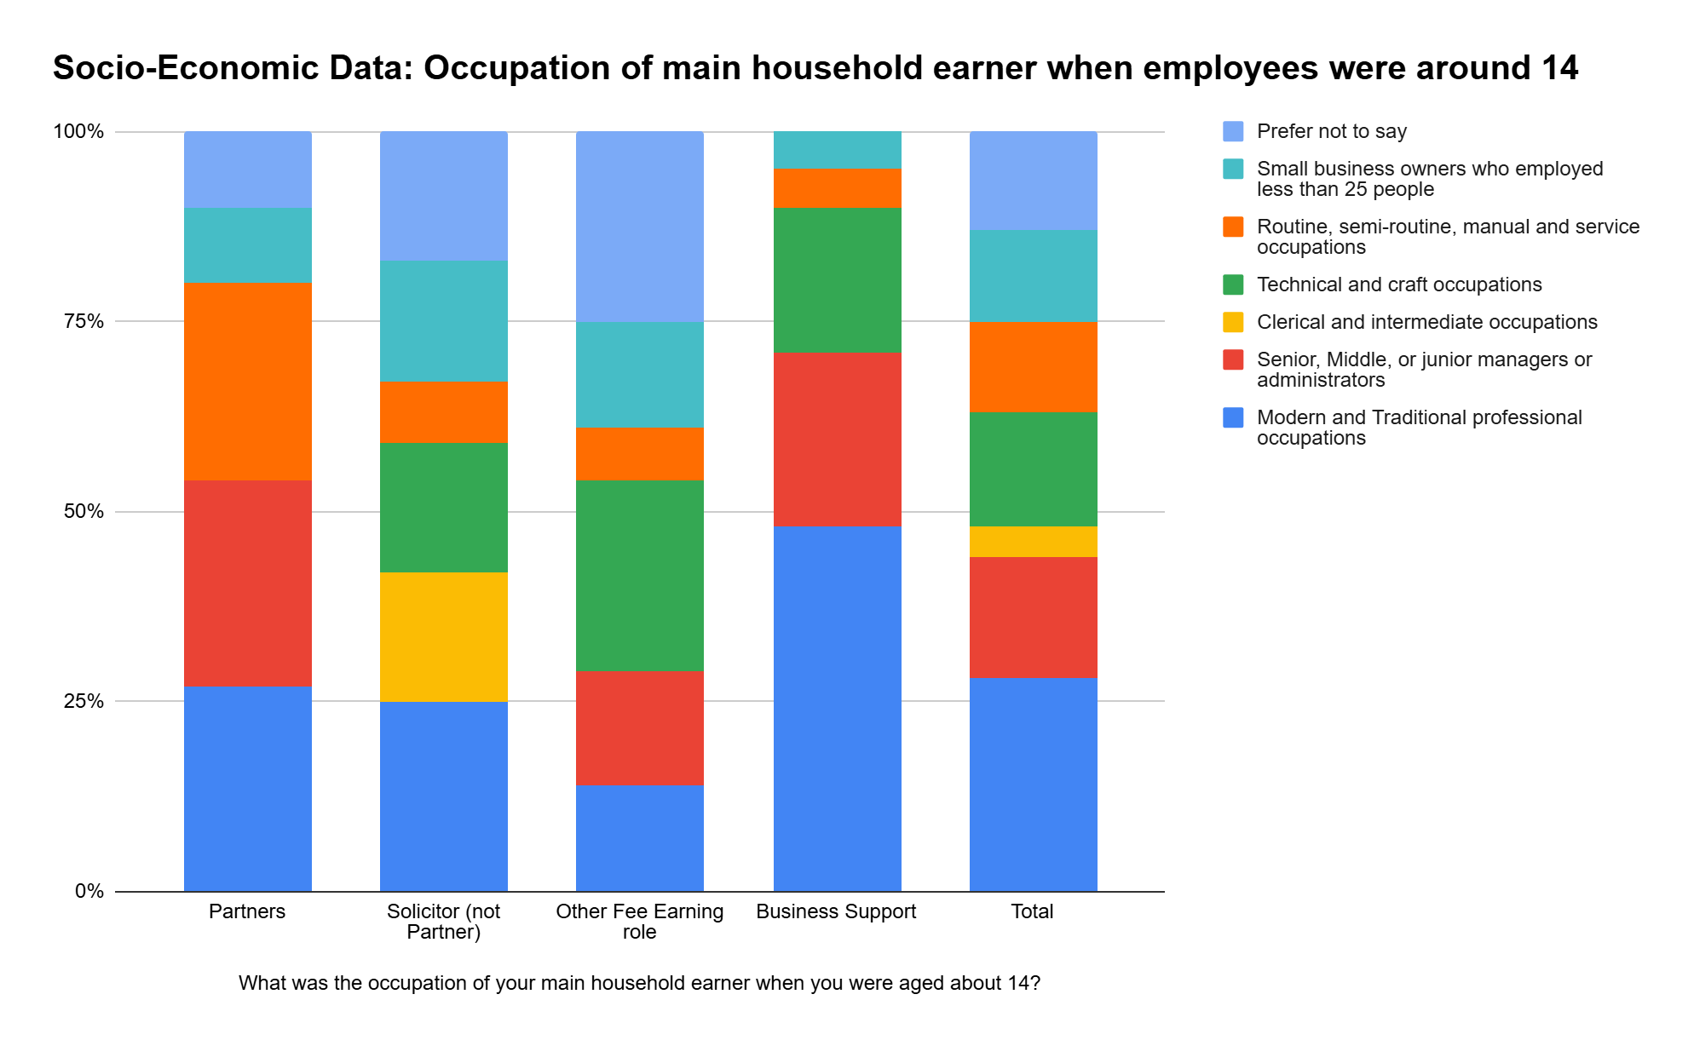
Socio-Economic Data Report 2025
10%
5%
17%
5%
13%
25%
3%
10%
10%
12%
17%
4%
10%
19%
10%
16%
25%
14%
14%
9%
26%
12%
8%
9%
16%
16%
23%
7%
14%
15%
26%
11%
17%
8%
4%
7%
25%
12%
27%
17%
16%
17%
25%
27%
100%
17%
63%
15%
46%
27%
25%
15%
48%
28%
27%
25%
14%
14%
10%

Slide 11
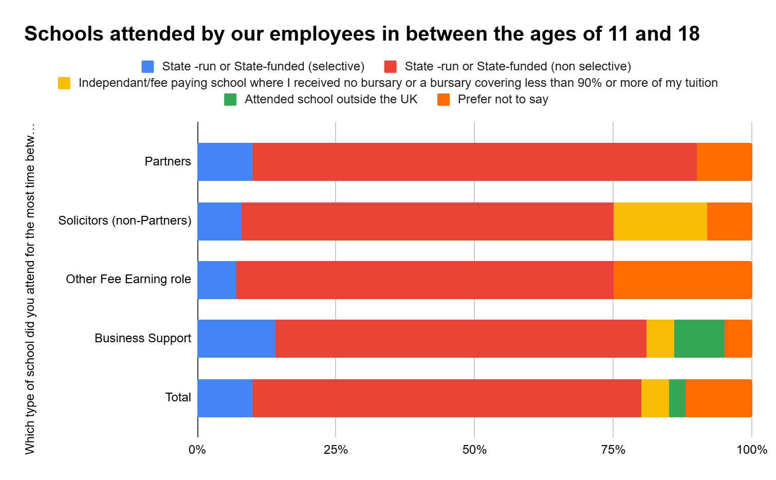
Socio-Economic Data: Continued.
70% of our employees attended a non-selective state run/state funded school.
10%
8%
6%
9%
10%
80%
10%
25%
13%
3%
17%
4%
3%
8%
67%
17%
8%
80%
7%
67%
68%
63%
100%
25%
68%
76%
14%
67%
5%
9%
5%
10%
10%
8%
7%
70%
17%
12%
5%
8%
3%

Slide 12
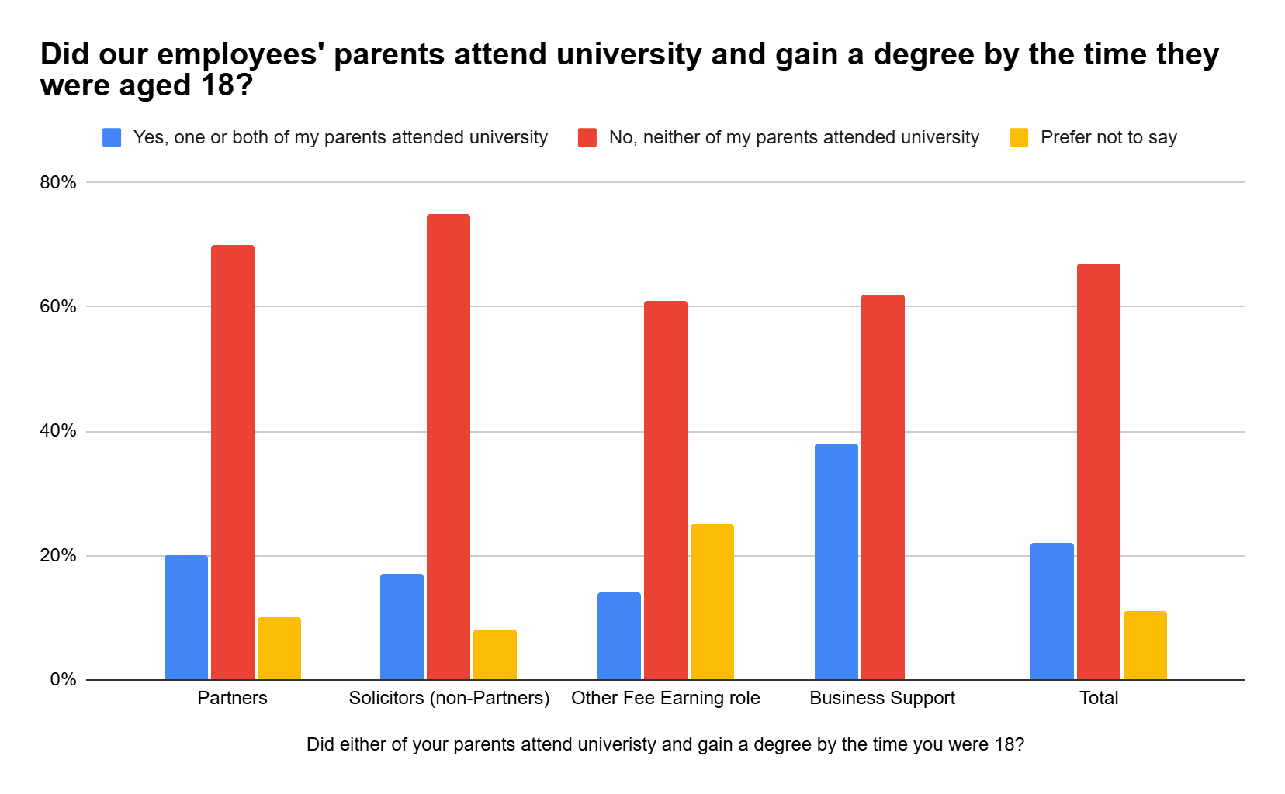
Social Mobility Data: Did our employees’ parents attend university?
75%
70%
100%
67%
61%
62%
75%
70%
61%
50%
38%
51%
50%
40%
25%
22%
20%
25%
20%
17%
17%
14%
10%
14%
11%
10%
8%
9%
8%

Slide 13
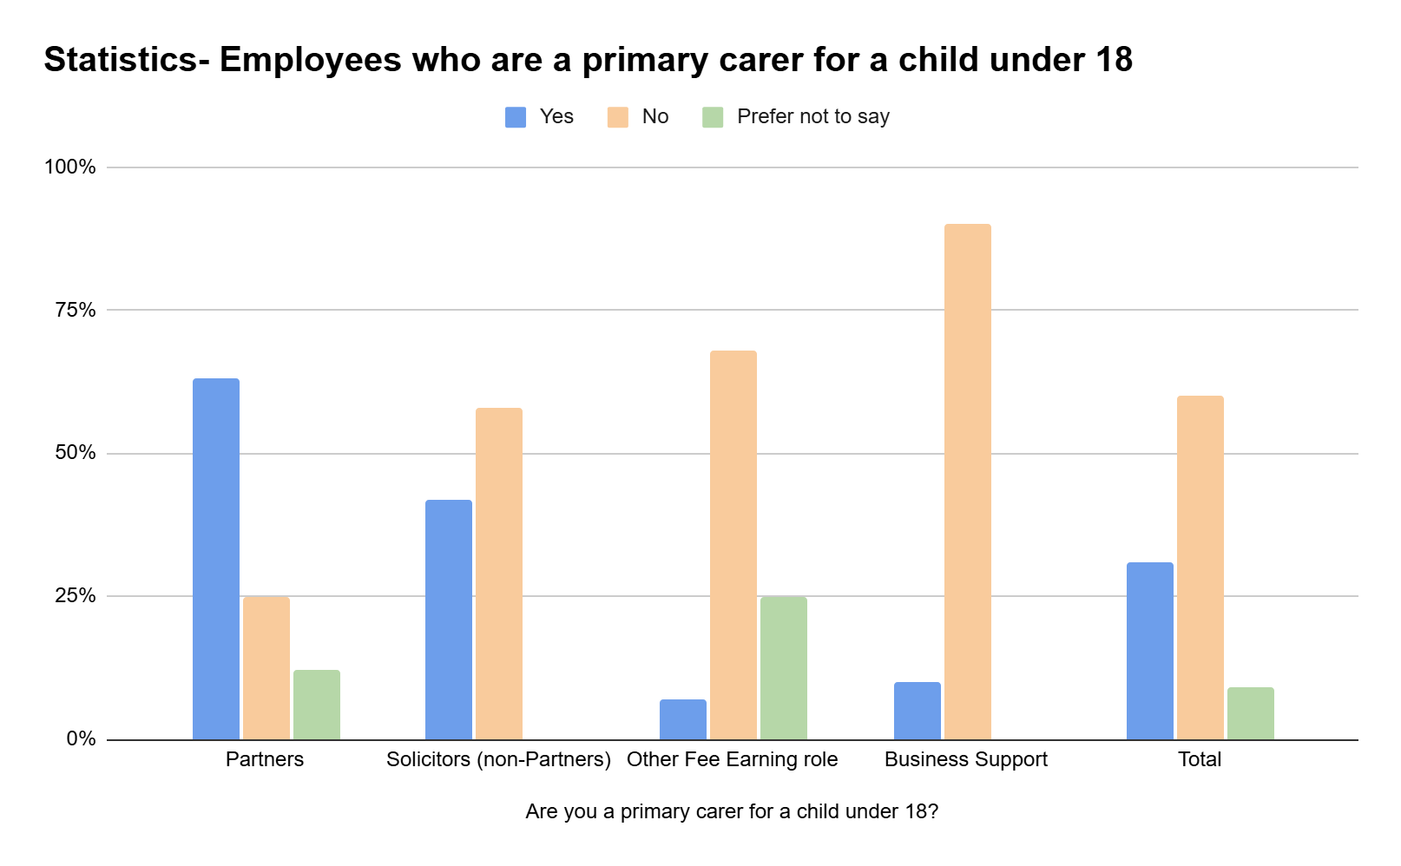
Diversity report on Primary Carers 2025
31% of our employees are a primary carer for a child under 18.
100%
87%
90%
63%
68%
68%
63%
58%
60%
58%
42%
42%
31%
25%
25%
25%
25%
12%
10%
9%
13%
7%
12%
7%
8%
TOTAL
TOTAL
68%
25%
68%

Slide 14
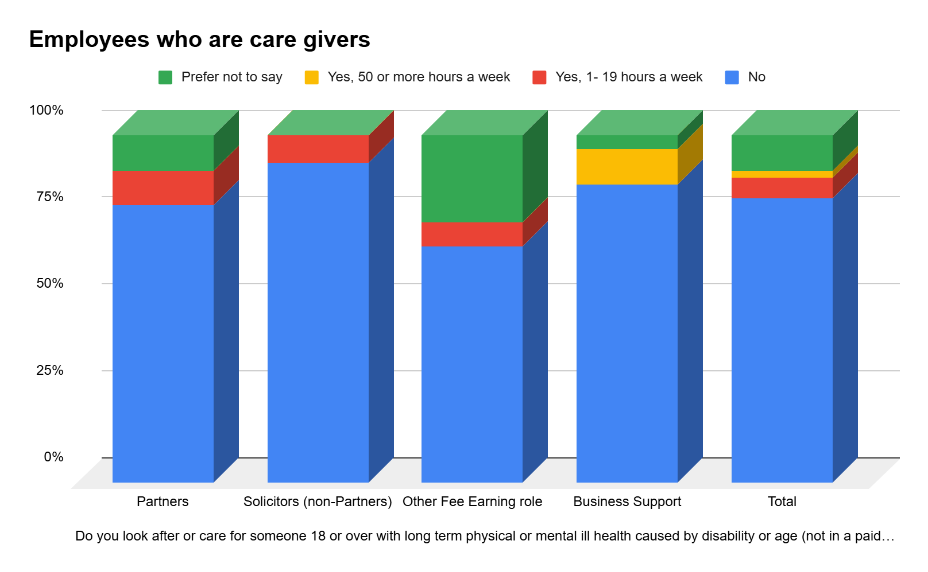
Diversity Report; Caregivers
1%
4%
4%
10%
8% of our staff look after or care for someone over 18, alongside their employment.
10%
10%
8%
8%
8%
6%
10%
2%
10%
25%
6%
10%
25%
5%
7%
5%
1%
7%
80%
92%
68%
90%
100%
86%
86%
80%
92%
68%
86%
82%

